Slide 1
American Energy Market Regulator – Executive Presentation Using SQL Queries
Date: February 20, 2019
Presenter: Justin Albright

Slide 2
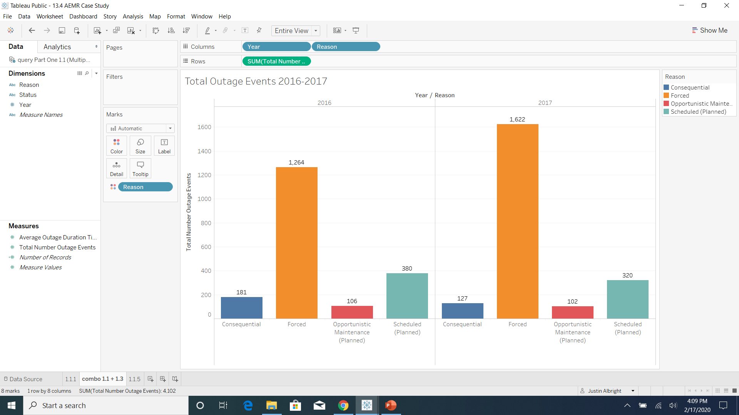
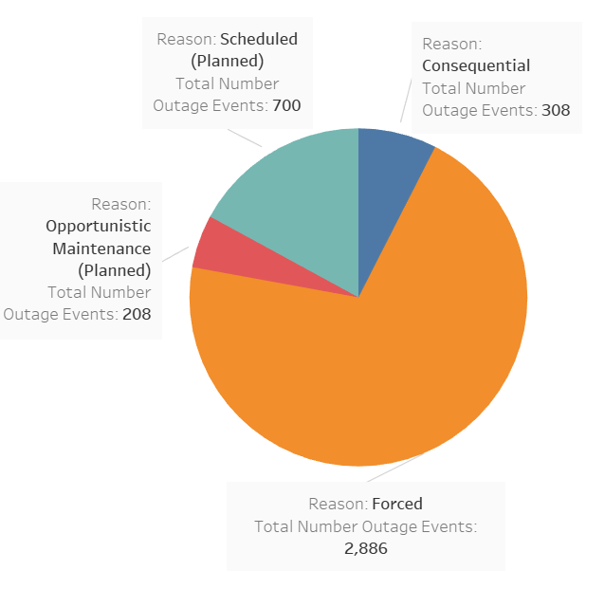

Forced outages are a major problem, and are growing year-over-year
Key Insights
Forced, unplanned outages make up the large majority of outages (over 70%) and are growing.
Forced outages were the only type of the four which grew year over year, growing by 28%.

Slide 3
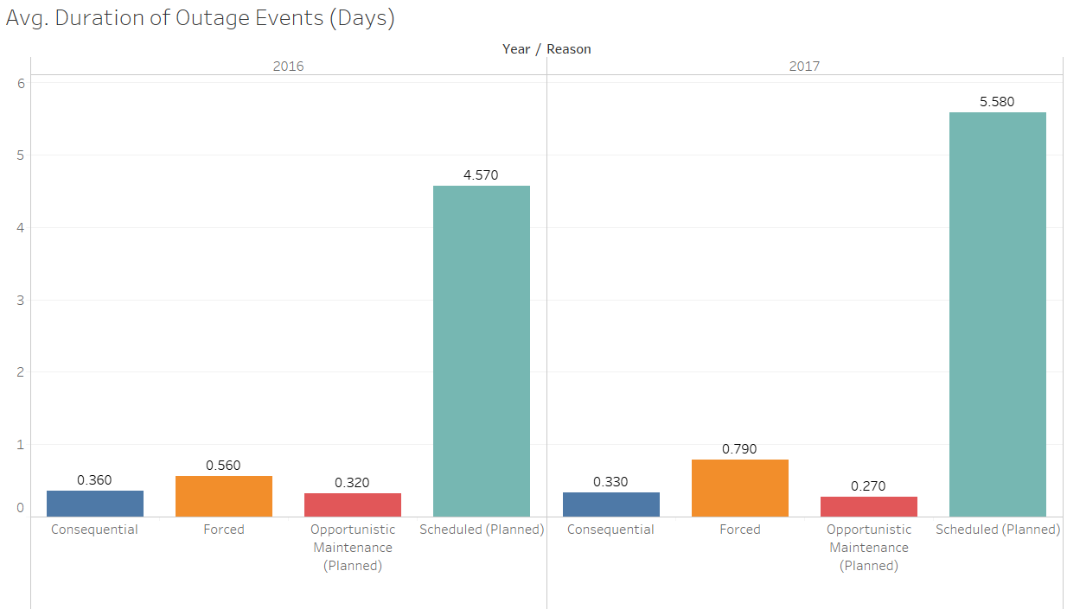
Length of Outages is also a cause for concern
Key Insights
Outage duration is also growing year over year. Forced outage length has grown over 40% to about 19 hours on average in 2017.
Scheduled outages have also grown over 20% to about 5.6 days on average in 2017

Slide 4
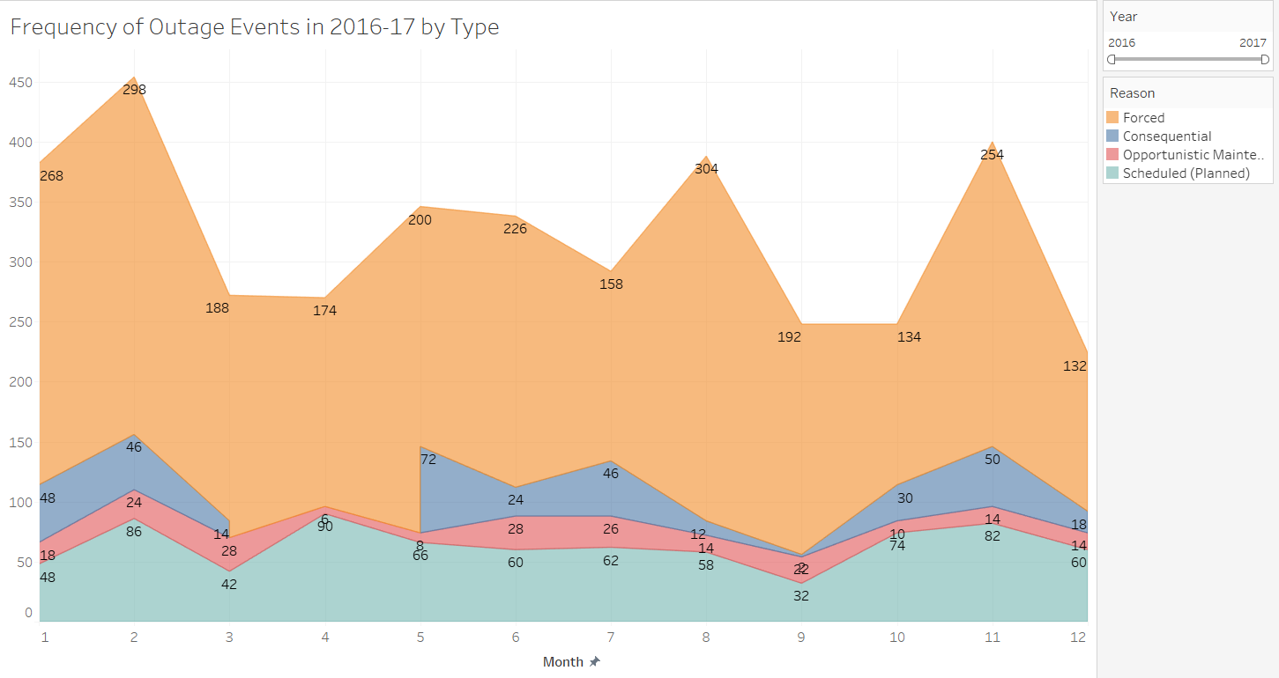
Outages occur in the hundreds every month, but forced outages are particularly erratic
Key Insights
Forced outages appear erratic, but do have some seasonality. These outages seem to spike in Jan, Feb, Aug, and Nov of each year.
Opportunistic and scheduled outages tend to follow a more regular pattern.

Slide 5
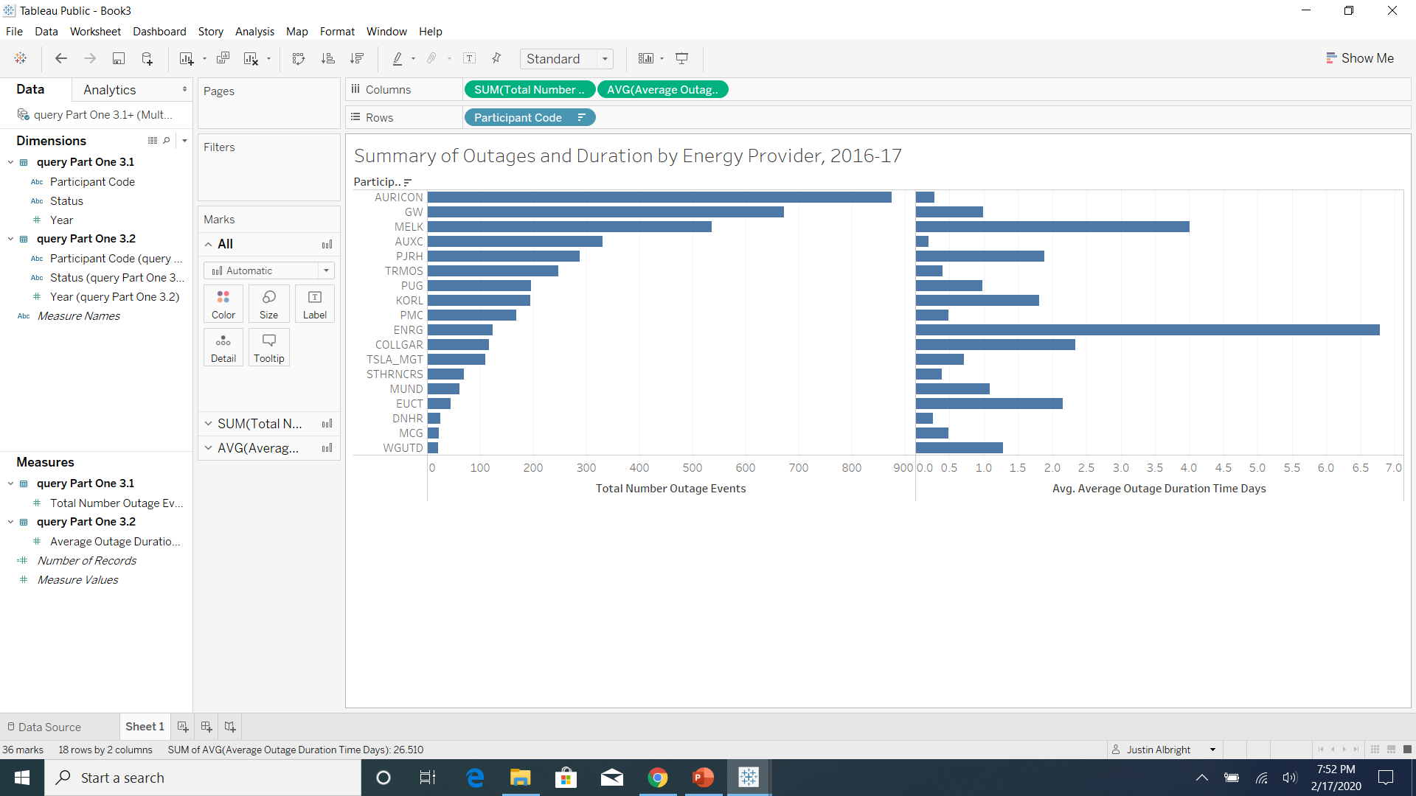
Reliability concerns can be pinpointed to a handful of energy providers
Key Insights
Over half of all outages can be traced back to just 3 energy providers – Auricon, GW, and Melk.
The top two, Auricon and GW, have relatively short outage durations relative to their frequency. The third, Melk is of particular concern, because it has high outage frequency (over 500) as well as very high duration (avg. of 4 days).
Melk and Enrg stand out with very high duration times.
Further analysis is necessary to review forced outages, as this summary includes all four outage types. Note that scheduled outages are much longer on average than the other three types, which could be skewing the results.

Slide 6
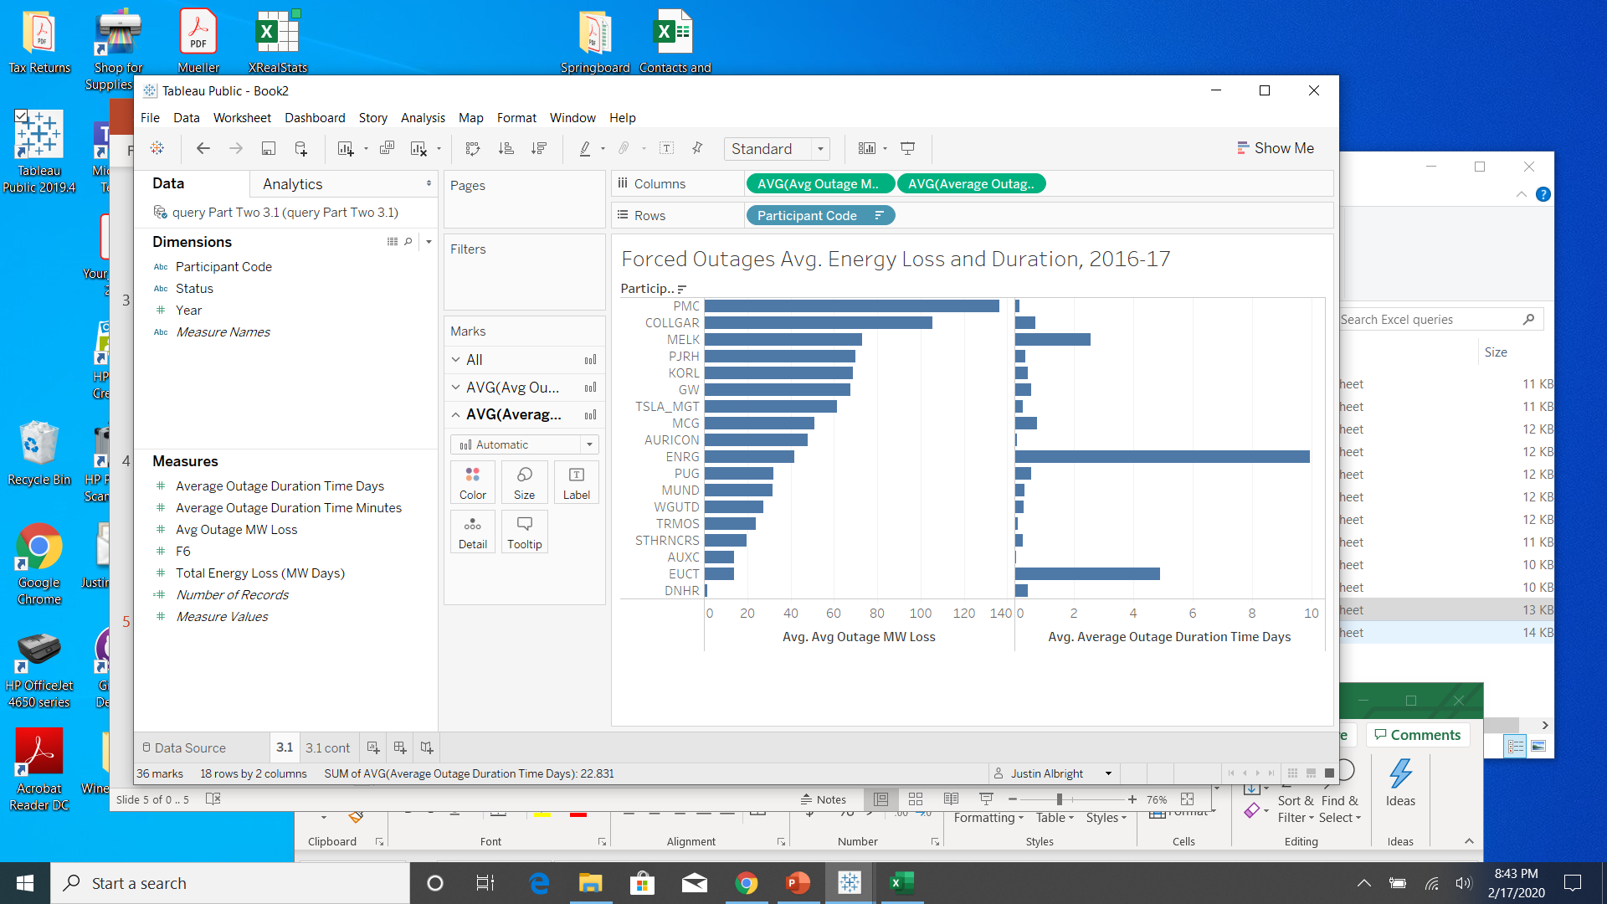
Analysis of forced outages by provider yields some surprising results
Key Insights
Only one of the top three in total outage events (from previous slide), Melk, is in the top three of forced outage avg. energy loss. Auricon and GW are not noteworthy regarding their energy loss, and have among the lowest duration times.
Engr still stands out as having extremely high avg. duration time (almost 10 days).
A combination (multiplication) of these two measures will reveal which providers are responsible for the greatest total loss from forced outages.

Slide 7
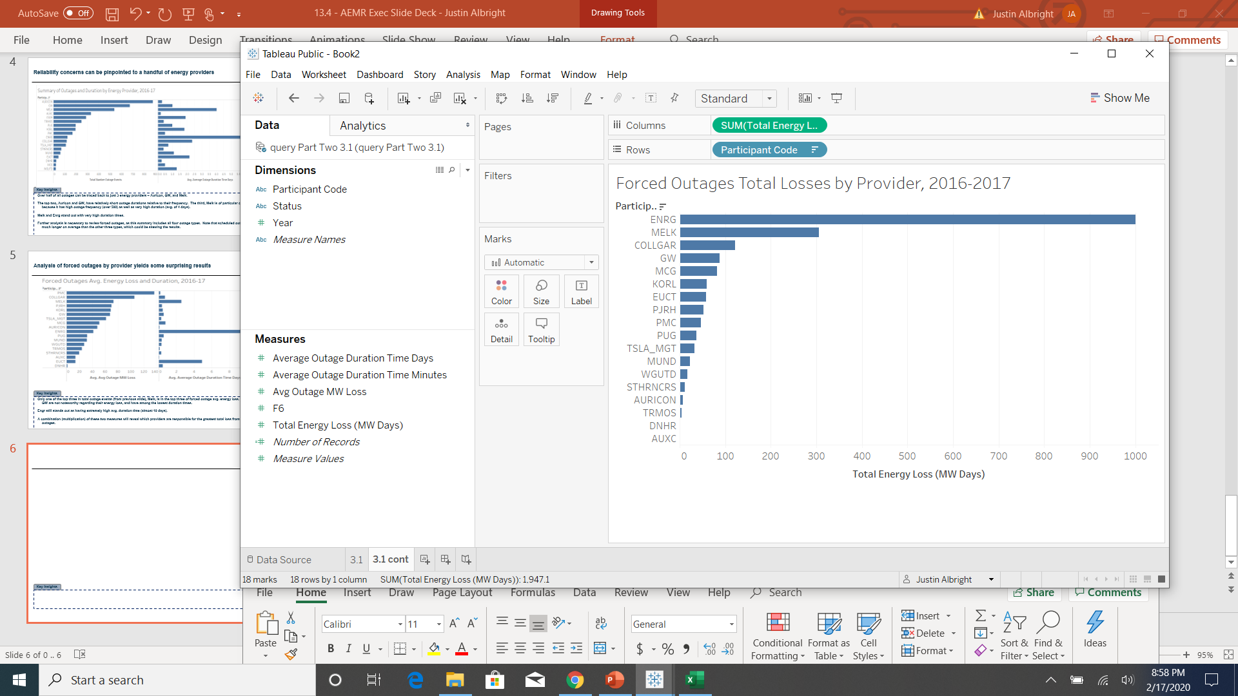
Forced outage loss is the result of a handful of unreliable providers
Key Insights
Engr alone is responsible for 1,000 MW days of energy loss, over half of the total 1,947 MW days lost in 2016-2017.
The next two largest, Melk and Collgar, make up roughly a quarter of the total unplanned, forced loss.
In AEMR’s role, I would recommend holding these 3 providers (especially Engr) more accountable, or divert the energy they provide to be the responsibility of the more reliable energy suppliers.

